Slide 1

Session 2 DATA STORAGE STRUCTURES
Trainer: Ms Shirley Komogi
Centre of Excellence in IT

Slide 2
Contents
Introduction to Data Storage Structures
Overview of Physical and Logical structures in a database.
Relationship between physical and logical structures
The primary logical structure in a database called a TABLESPACE
Physical files
Control files
Data files
Structured data
Unstructured data

Slide 3
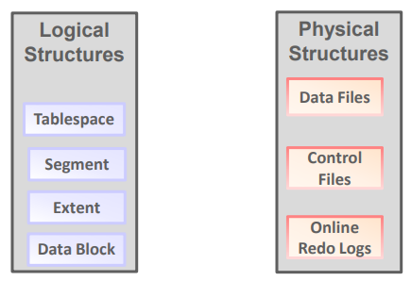
Introduction to Data Storage Structures in a database.
Data storage is one of the essential tasks of the database.
The database has physical structures and logical structures.

Slide 4
Overview of Physical Structure in a database.
The data in database management system (DBMS) is stored on physical storage devices such as main memory and secondary (external) storage.
The set of files that store data in persistent disk storage.
The database files generated when you issue a CREATE DATABASE statement:
A data file is a physical file on disk that was created by Database and contains data structures such as tables and indexes.
A temp file is a data file that belongs to a temporary tablespace. The database writes data to these files in an proprietary format that cannot be read by other programs.
A control file is a root file that tracks the physical components of the database.
The online redo log is a set of files containing records of changes made to data.
Most databases store files in a file system, which is a data structure built inside a contiguous disk address space. All operating systems have file managers that allocate and deallocate disk space into files within a file system.
A file system enables disk space to be allocated to many files. Each file has a name and is made to appear as a contiguous address space to applications such as Database. The database can create, read, write, resize, and delete files.

Slide 5
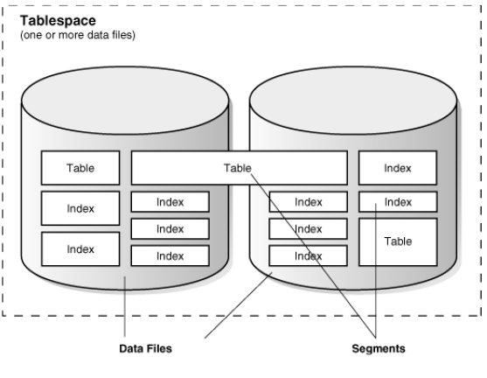
Data files
Database creates a data file for a tablespace by allocating the specified amount of disk space plus the overhead for the data file header.
Notes:
The data file header contains metadata about the data file such as its size and checkpoint SCN. Each header contains an absolute file number, which uniquely identifies the data file within the database, and a relative file number, which uniquely identifies a data file within a tablespace.
Database first creates a data file, the allocated disk space is formatted but contains no user data. However, the database reserves the space to hold the data for future segments of the associated tablespace. As the data grows in a tablespace Database uses the free space in the data files to allocate extents for the segment.

Slide 6
Control files
The database control file is a small binary file associated with only one database.
A control file contains the following type of information: Database name and database unique identifier (DBID)
Time stamp of database creation
Information about data files and online redo log files
Tablespace information
Current log sequence number
Metadata that must be accessible when the database is not open
Notes:
The data file header contains metadata about the data file such as its size and checkpoint SCN. Each header contains an absolute file number, which uniquely identifies the data file within the database, and a relative file number, which uniquely identifies a data file within a tablespace.
Database first creates a data file, the allocated disk space is formatted but contains no user data. However, the database reserves the space to hold the data for future segments of the associated tablespace. As the data grows in a tablespace Database uses the free space in the data files to allocate extents for the segment.
The control file serves the following purposes:
It contains information about data files, online redo log files, and so on that are required to open the database.
The control file tracks structural changes to the database. For example, when an administrator adds, renames, or drops a data file or online redo log file, the database updates the control file to reflect this change.
It contains metadata that must be accessible when the database is not open.
For example, the control file contains information required to recover the database, including checkpoints. A checkpoint indicates the SCN in the redo stream where instance recovery would be required to begin. Every committed change before a checkpoint SCN is guaranteed to be saved on disk in the data files. At least every three seconds the checkpoint process records information in the control file about the checkpoint position in the online redo log.

Slide 7
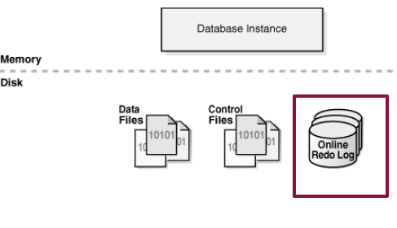
Online Redo Log Files
Online Redo Log Files
Every instance of a database has an associated redo log to protect the database in case of an instance failure.
The redo log for each database instance is also referred to as a redo thread.
consists of two or more pre-allocated files that store changes to the database as they occur. The online redo log records changes to the data files.
Notes:
Use of the Online Redo Log
The database maintains online redo log files to protect against data loss. Specifically, after an instance failure, the online redo log files enable Oracle Database to recover committed data that it has not yet written to the data files.
Server processes write every transaction synchronously to the redo log buffer, which the LGWR process then writes to the online redo log. Contents of the online redo log include uncommitted transactions, and schema and object management statements.
As the database makes changes to the undo segments, the database also writes these changes to the online redo logs. Consequently, the online redo log always contains the undo data for permanent objects. You can configure the database to store all undo data for temporary objects in a temporary undo segment, which saves space and improves performance, or allow the database to store both permanent and temporary undo data in the online redo log.
Oracle Database uses the online redo log only for recovery. However, administrators can query online redo log files through a SQL interface in the Oracle LogMiner utility (see "Oracle LogMiner"). Redo log files are a useful source of historical information about database activity.
How Oracle Database Writes to the Online Redo Log
The online redo log for a database instance is called a redo thread.
In single-instance configurations, only one instance accesses a database, so only one redo thread is present. In an Oracle Real Application Clusters (Oracle RAC) configuration, however, multiple instances concurrently access a database, with each instance having its own redo thread. A separate redo thread for each instance avoids contention for a single set of online redo log files.
An online redo log consists of two or more online redo log files. Oracle Database requires a minimum of two files to guarantee that one file is always available for writing in case the other file is in the process of being cleared or archived.

Slide 8
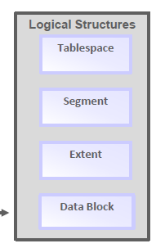
Overview of Logical Structure in a database.
Database allocates logical space for all data in the database. The logical units of database space allocation are data blocks, extents, segments, and tablespaces.

Slide 9
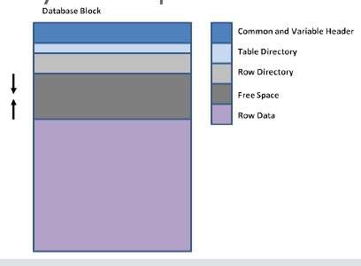
Data Block
A data block is the smallest logical storage unit of a database.
A single data block represents a specific number of bytes on the physical hard disk.
The size of a data block is generally a multiple of the operating system block size.

Slide 10
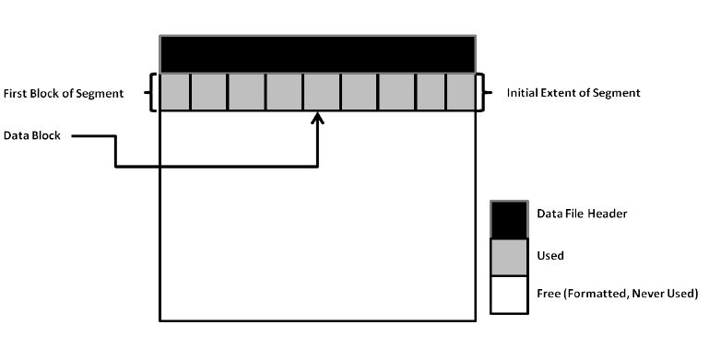
Extent
An extent is a logical unit of database storage space allocation made up of contiguous data blocks.
An extent is a set of logically contiguous data blocks allocated for storing a specific type of information

Slide 11
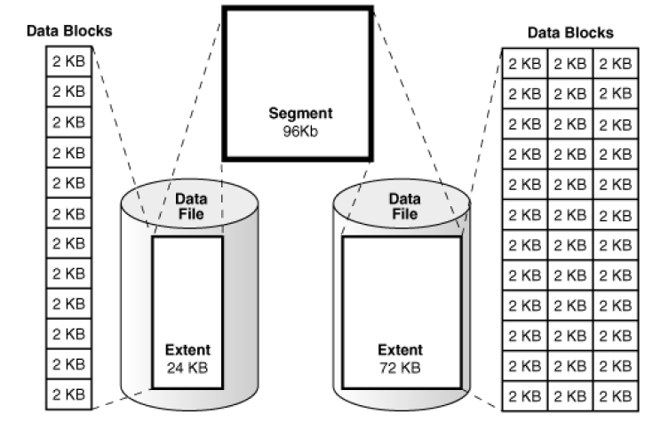
Segment
A segment is a set of extents allocated for a specific database object, such as a table.
For example, the data for
the employees table is
stored in its own data
segment, whereas each
index for employees is
stored in its own index
segment. Every database
object that consumes
storage consists of a
single segment.

Slide 12
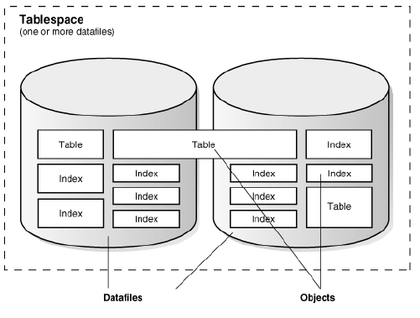
Tablespace
A tablespace is a database storage unit that contains one or more segments.
Each segment belongs to one and only one tablespace. Thus, all extents for a segment are stored in the same tablespace. Within a tablespace, a segment can include extents from multiple data files, as shown in the preceding graphic.
For example, one extent for a
segment may be stored in
users01.dbf, while another is
stored in users02.dbf.

Slide 13
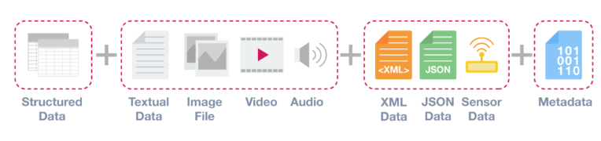
Data Structures
For the analysis of data, it is important to understand that there are three common types of data structures:
Structured data
Unstructured data
Semi- Structured data

Slide 14
Structured Data
Structured data is data that adheres to a pre-defined data model and is therefore straightforward to analyze.
Structured data conforms to a tabular format with relationship between the different rows and columns.
Examples of structured data are Excel files or SQL databases. Each of these have structured rows and columns that can be sorted.
Notes:
Structured data depends on the existence of a data model – a model of how data can be stored, processed and accessed. Because of a data model, each field is discrete and can be accesses separately or jointly along with data from other fields. This makes structured data extremely powerful: it is possible to quickly aggregate data from various locations in the database.
Structured data is is considered the most ‘traditional’ form of data storage, since the earliest versions of database management systems (DBMS) were able to store, process and access structured data.

Slide 15
Unstructured Data
Database also provides support for unstructured data, which cannot be decomposed into standard components. Unstructured data includes text, graphic images, video clips, and sound waveforms.
Data that is usually not as easily searchable, including formats like audio, video, and social media postings.
Notes:
Database includes data types to handle unstructured content. These data types appear as native types in the database and can be queried using SQL.
Unstructured Data
Unstructured data is information that either does not have a predefined data model or is not organised in a pre-defined manner. Unstructured information is typically text-heavy, but may contain data such as dates, numbers, and facts as well. This results in irregularities and ambiguities that make it difficult to understand using traditional programs as compared to data stored in structured databases. Common examples of unstructured data include audio, video files or No-SQL databases.
The ability to store and process unstructured data has greatly grown in recent years, with many new technologies and tools coming to the market that are able to store specialised types of unstructured data. MongoDB, for example, is optimised to store documents. Apache Giraph, as an opposite example, is optimised for storing relationships between nodes.
The ability to analyse unstructured data is especially relevant in the context of Big Data, since a large part of data in organisations is unstructured. Think about pictures, videos or PDF documents. The ability to extract value from unstructured data is one of main drivers behind the quick growth of Big Data.

Slide 16
Semi-Structured Data
Semi-structured data is a form of structured data that does not conform with the formal structure of data models associated with relational databases or other forms of data tables,
but nonetheless contain tags or other markers to separate semantic elements and enforce hierarchies of records and fields within the data. Therefore, it is also known as self-describing structure.
Examples of semi-structured data include JSON and XML are forms of semi-structured data.
Notes:
The reason that this third category exists (between structured and unstructured data) is because semi-structured data is considerably easier to analyse than unstructured data. Many Big Data solutions and tools have the ability to ‘read’ and process either JSON or XML. This reduces the complexity to analyse structured data, compared to unstructured data.

Slide 17


